Slide 1

Transformations
Reading: 1.4
exercises: Ch.1: 27, 29abc, 31, 32abc
Assigned: hw 3
Producer: dr. mario
img credit: alex riegert-waters

Slide 2
Reasons for Data Transformations
Can Be Done on Response Y or Predictor X
Reasons for Data Transformations
Address Non-Linear Patterns
Stabilize Variance (Homoscedasticity)
Make Residuals More “Normally Distributed”
Minimize Effect of Outliers
Focus is on Non-Linear Transformations

Slide 3

Most Common Types
Logarithmic: $Y^{′}=log⁡(Y)$
Power Function $Y^{′}=Y^{k} where k∈ℝ$
Square Root (Special Case when k=2)
Reciprocal (Special Case when k=-1)
Exponentiation: $Y^{′}=k^{Y}$
Exponential Growth $Y^{′}=e^{Y} where e=2.71828 (Constant)$

Slide 4
Choosing Transformations
Monotonicity: Always increasing or decreasing
Easily Solvable for Y: Need to Get Predictions For Y
Stronger Linear Pattern: Look at Scatterplots
Better Residuals: Look at Plots of Residuals
Box-Cox Transformation: Helpful Method Not in Text

Slide 5
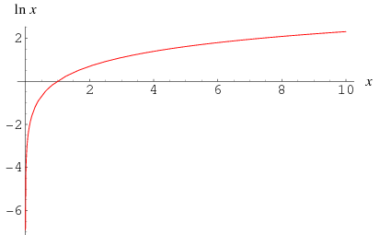

Log Transformation
Log Scales Seen in Science (Loudness, Earthquake, Acidity)
Helpful With Converting Multiplicative to Additive
Rule: $\log\left(ab\right)=\log\left(a\right)+log⁡(b)$
Helpful With Converting Scales
Income is Always Positive (Linear Regression Appropriate?)
Default in Statistics: Natural Log (Base e)

Slide 6

Log Transformation
Signs a Log Transformation Might Be Useful (For Y or X)
Variables are Highly Right Skewed
Values Range Over 2 or More Orders of Magnitude (Need Reference Value: Common is ${10}^{k}$)
Scatterplot Shows Logarithmic Growth
Plot of Residuals Show “Fanning Out” or “Megaphone”
Multiplicative or Proportional Relationships are Reasonable
Easily Solvable: $Y^{′}=log⁡(Y)$ and $Y^{′}=β_{0}+β_{1}X+ε$
$$\hat{Y}=\exp\left(\hat{β_{0}}+\hat{β_{1}}X\right)=e^{\left(\hat{β_{0}}+\hat{β_{1}}X\right)}=e^{\hat{Y^{′}}}$$

Slide 7
Thank You
Make Reasonable Decisions

